Slide 1
Maximize security and minimize costs with Equitrac
Simply and securely print what you need, when you need it and where you need it
May 2019

Slide 2




Market Challenges & Pressures
Our market today mandates that organizations employ solutions that help them successfully
maneuver through our economical changes. This includes in our print environments.
Compliance & Security Risks
Digital Transformation
Mobile
Workforce
Business Process Efficiency
Notes:
Minimize Compliance Risks
One issue that keeps CIO’s and CEO’s alike up at night is the possibility of a security breach and the grave consequences it brings. Your reputation, your customer data and your bottom line are all at stake if your organization falls prey to a cyberattack. CIOs need to minimize security risks especially in the wake of GDPR -- 63% of organizations have reported a print related data breach while 90% of organizations have reported a print related data loss . As such they need to develop a unified security strategy that reduces risks as much as possible and helps the organization adhere to compliance regulations.
Digital Transformation
Currently digital transformation and supporting technologies dominate the CIO’s agenda. In addition, according to a 2018 report from Gartner, “84 per cent of CIOs at top-performing organizations have responsibility for areas of the business outside traditional IT, the most common being innovation and transformation. Organizations, particularly CIOs & CTOs need to stay abreast of a digital economy including making wise technology investments to facilitate digitization. “CIOs are only going to be successful… if the investments they're making are driving business outcomes." Matt Guarini, VP & research director at Forrester.
Mobile Print
Mobile print demands and BYOD adds another level of complexity to print security for CIOs. They are pressured to expertly manage the mobile print challenges with BYOD added to the multiple locations and countries. Bugcrowd detected a 21% increase over the past year in security vulnerabilities in connected devices, including printers, laptops and smartphones
Improving business process efficiency
Improving business process efficiency and reducing cost of operation while remaining flexible to match custom requirements is at the top of the CIO’s agenda. This is especially critical when much of their network is a blend of multiple vendors and legacy systems. They need to implement and secure a mixed fleet of printers in an enterprise network to maintain the privacy and security paper files without breaking the bank.

Slide 3
Current Market Environment
‘‘
‘‘
The average cost of a
data breach is $3.86 million,
a 6.4% increase from 2017
The BYOD practice is exploding as BYOD adoption rates increased to 36% in 2017
‘‘
(Ponemon Institute, Cost of a Data Breach)
‘‘
(5 BYOD Risks to avoid…)
85% of decision makers feel
they have <2 years to advance their digital transformation before suffering financially & falling behind
39% of Millennials print from mobile devices, placing greater importance on mobile print security
(Digital Transformation Statistics Every CIO Should Know in 2017)
(35 cyber security statistics every CIO should know in 2017)
Notes:
Market trends mandate that organizations make changes and soon. The push towards digital transformation is real. In addition the likelihood and cost of breach keeps increasing along with the demands for mobile devices.

Slide 4

The printer security gap
63% of organizations have reported a print-related
data breach while 90% of
organizations have reported
a print-related data loss
Reports show 71% of all cybersecurity incidents are
caused by inadvertent employee actions—including leaving private printed documents unattended
Bugcrowd detected a 21% increase over the past year
in security vulnerabilities in connected devices including printers, laptops & smartphones
Hackers are still getting around hardware security as they look
for ways to infiltrate enterprise systems and networks
Sensitive data is exposed through careless handling of documents—a risk in the wake of GDPR and stronger regulations
BYOD exposes organizations
to threats through unsecured
devices, demanding additional layers of security
Notes:
The rise too of IOT devices including printers and the agility of nefarious actors mandate a change in the way we secure our printer networks and our documents.
75% of organizations say they’re not completely confident that their internet-connected printers would be safe from a cyber-attack.

Slide 5
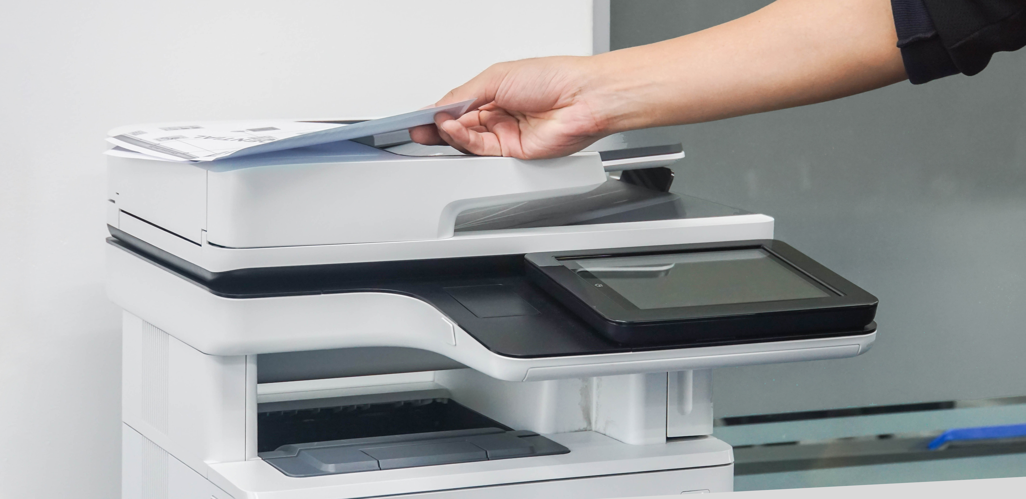
No industry is immune…
‘‘
94% of office workers have 1+ bad printing habit that is an organizational security risk
Thrown away printed
documents without shredding
Left copies in the printer tray
Picked up someone else’s documents from the printer
Massachusetts General Hospital was fined $1M in HIPAA violations for leaving detailed information of HIV patients on their printers
(SC Media UK, June 2016)
Notes:
Research and surveys prove that printer security is indeed an issue:
94 percent of office workers have at least one bad printing habit that is risking security in their organization. {Danwood}

Slide 6




What if you could …
Minimize your security risks and avoid compliance issues with the resulting regulatory fines?
Drive your digital transformation and business outcomes?
Improve your business process efficiencies and reduce cost of operation?
Expertly manage your mobile print challenges and their security risks?

Slide 7

Equitrac Helps…
Mitigate and minimize security risks by enforcing user-centric print and capture policies
Reduce the risk of failed compliance audits
Reduce hard print and labor costs,
while increasing workforce productivity
Provide a unified user experience for managing information print, capture, and routing
Simplify and centrally manage mixed MFP fleets
Notes:
Solution:
Kofax Equitrac 6 delivers the most powerful and flexible print management solution on the market. Its’ superior security features help organizations close the printer security gap and improve compliance. Equitrac’s multi-faceted, feature rich capabilities scale easily in any environment, from small businesses to large enterprises with multiple offices and a myriad of different print devices. Since Equitrac is a critical component of the ControlSuite stack users can achieve greater benefits by leveraging the entire stack
Mitigate and minimize security risks by enforcing user-centric print and capture policies
Enables follow-you printing ensuring workers can print and pick documents on-demand anywhere, anytime
Secures device with user-based authentication and access controls via mobile devices, or a touch screen or card reader on the MFP
Delivers advanced information protection such as watermarking, encryption and conversion
Reducing the risk of failed compliance audits
Offers file quarantine and other data lass prevention methods
Tracks all print, capture and routing activities in configurable reports
Establishes chain of custody documenting who has accessed or printed information
Reducing hard print and labor costs, while increasing workforce productivity
Delivers diagnostics and controls to manage print usage and behaviors by user, department or device
Supports mobile workforce by enabling information print, capture, processing and routing from a mobile device
Provides print failover, automatically re-routing print activities based on rules to reduce interruption
Providing a unified user experience for managing information print, capture and routing
Offers single installer and consistent user experience for administering print, capture and workflows
Single mobile app for users to manage their print, capture and routing needs
Supports on-premise or cloud deployments
Simplify and centrally manage mixed MFP fleets
Single, integrated authentication platform makes user authentication easy and robust
Allows IT to easily control and enforce print, capture and routing controls across any MFP devices
Offers the business visibility into print and data capture behavior and costs
Creates consistent user experience across all MFP devices increasing usability

Slide 8

How Equitrac Works
Minimize security risks; avoid compliance issues and regulatory fines
Help ensure that they secure all vulnerabilities and network gaps to minimize the
risk of cyberthreats including their printers and print management software
Drive digital transformation and business outcomes
Provide multi-faceted, feature rich solutions that scale easily in any environment,
from small businesses to large enterprises with multiple offices and thousands of devices.
Improve business process efficiencies and reduce cost of operation
Deliver secure, enterprise level solutions including print management software to
minimize the security risks that printers pose and improve document security
Expertly manage the mobile print challenges and their security risks
Deliver print management software that provides multiple ways of authenticating using
a mobile device, enabling employees to print securely from anywhere and from any device
thus minimizing the risk of a security breach.

Slide 9
Equitrac 6 Capability Overview
Equitrac Foundations |  | Equitrac Enterprise
 |  | Includes all Foundations features plus:
Follow-You Printing, Reporting |  | High Availability
Quota Management and Chargeback |  | Mainframe and Host Printing | New
Rules & Routing |  | Enhanced Security (Watermarking/User information stamping) | New
Basic capture with OCR (Scan to Email, Folder, SharePoint, Home and Network folder) | New | Basic Capture Plus (Rightfax, HA) | New
Business Connect Mobile Print Release and Submission | New | Mobile Print Submission and Release + Capture | New

Slide 10
Why Equitrac 6
For knowledge workers
For your
C-Suite
For
IT staff
A global leading scalable and secure print solution, with consistent and simplified licensing that makes the solution easy to order, deploy, and use.
A secure, easy-to-use solution that enables knowledge workers to perform tasks more efficiently and conveniently, freeing time for more value-added activities.
Easy to install, manage, and administer solution that delivers the versatility to maximize cost savings and increase security and governance while minimizing print infrastructure costs.
Notes:
As the leading global print management solution, customers should feel comfortable in the knowledge that they are being supported by the industry leader. Simplified pricing and licensing, in addition to pricing and policy alignment with other ControlSuite products,
Support for the latest OS, an improved security architecture, and an ongoing focus on security enhancements at the infrastructure, workflow, and document level, reduces risk and provide peace of mind for security-minded customers.
A new web-based UI improves usability and allows customers to administer the system from nearly anywhere. Simplifying the administrator experience and removing the need for configured Windows queues for secure document dramatically release reduces the administrative overhead required to deploy and maintain the system. Customers can invest more IT resources into other critical infrastructure items.
Our ControlSuite integrations allow customers to leverage all of Kofax’s print management solutions. For example, customers will be able to deploy other ControlSuite products with Equitrac to meet their complex scan workflow needs, and to bring back-office print into their Equitrac secure release workflow. This single-vendor solution to meet multiple needs simplifies the sales process, deployment, and ongoing support.
FOR KNOWLEDGE WORKERS:
Focus on ease of use – time savings
Feel confident that with added security features your documents are always safe and secure
Focus on productivity gains – allows knowledge workers to spend more time doing more value-added activities
Focus on specific integration workflows that solve unique customer pain points – by department, etc.
Providing secure print access to users whenever and wherever they need it
Supports mobile workforce with mobile printing capabilities, including Bluetooth and NFC (added security authentication)
FOR IT STAFF
Improved managed queues simplify administration for IT and knowledge workers
Enhanced security message (ex: watermarking) helps to reduce exposure of sensitive information
New web-based System Manager interface allows administration from anywhere
Focus on ability to minimize risk exposure, incident damage and network strain
Architectural security enhancements designed to combat ever-changing electronic data security threats
Additional performance metrics provide IT staff a better picture of what is occurring within the system
HA enhancements for authentication and server-less print submission provide more up-time and reliability

Slide 11
How Equitrac Works

Slide 12
How? – Security & Compliance
Secures your print management
Enables follow-you printing ensuring workers can print and pick documents on-demand anywhere, anytime
Secures device with user-based authentication and access controls via mobile devices, or a touch screen or card reader on the MFP
Delivers advanced information protection such as watermarking, encryption and conversion
Offers file quarantine and other data lass prevention methods
Tracks all print, capture and routing activities in configurable reports
Establishes chain of custody documenting who has accessed or printed information

Slide 13
How? – Drive Digital Transformation
Gives your organization flexibility
Provide multi-faceted, feature rich solutions that scale easily in any environment,
Deliver a solution that scales from small businesses to large enterprises with multiple offices and thousands of devices.

Slide 14
How? – Improve Business Processes
Makes your enterprise more productive
Delivers diagnostics and controls to manage print usage and behaviors by user, department or device
Supports mobile workforce by enabling information print, capture, processing and routing from a mobile device
Provides print failover, automatically re-routing print activities based on rules to reduce interruption

Slide 15
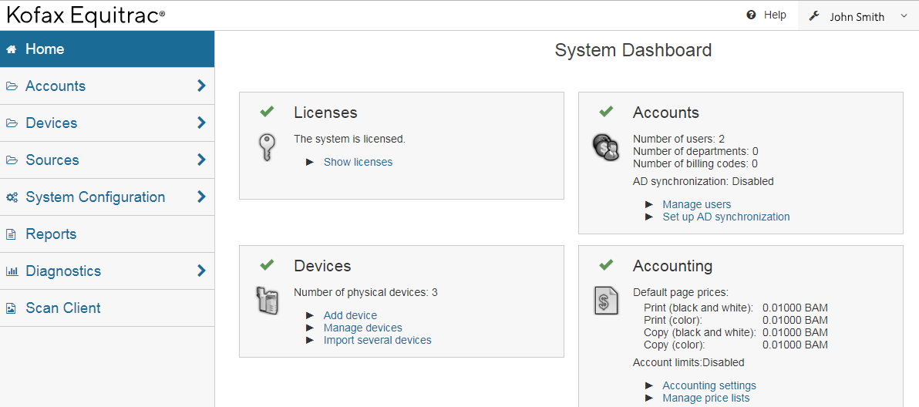
Equitrac New Features & Functionality

Slide 16

Enterprise Infrastructure Enhancements
High availability
High Availability for Authentication
Equitrac v6 shifts the cached authentication credentials into the system-wide distributed cache. This allows previously authenticated users to authenticate again at any device (when CAS is not accessible), not just those on the same DCE.
High Availability for Serverless Print Submission
Introduces a new security infrastructure for new shared components. Job submission high availability in this context ensures that the end user can successfully submit a job to a print queue, even when services like CAS and SLP are not available.
Load Balancer Support for Document Routing Engine (DRE)
Provides single data center HA for Print Submission via the use of a network load balancer. Enables maximum uptime for print submission via the use of network load balancers that allows organizations to benefit from near constant availability of their printing system.
Windows Cluster support
Equitrac still supports installation on Windows clusters. However, Microsoft deprecated support for print server clustering in Server 2008. This method of attaining high availability is no longer recommended.
High Availability Overview

Slide 17

Kofax Equitrac in the Cloud
Cloud administration and deployment convenience
Cloud deployable in private Cloud instances
Customer can host their own instance of Kofax Equitrac for their organization
Equitrac supports common Cloud OS implementations
Cloud instances must follow deployment specifications for operating system support
Equitrac supports major Cloud hosting vendors
  Examples would be:
    Microsoft Azure
    AWS Amazon Cloud
    IBM Cloud
    Google Cloud Platform
.
New with EQ 6.0
Cloud Deployment Overview
+ = dependent upon specific embedded clients

Slide 18


Infrastructure Enhancements
New Web-Based System Manager
New modern web-based user interface, built to meet industry standards.
Intuitive, flat design.
Easy to use and administer.
Runs on all modern browsers and supports Google, iOS & Android operating systems
Notes:
New Web System Manager to Replace Windows System Manager
Equitrac now has a lightweight administrative interface with an updated look and feel which will be used for system configuration and administration
Allows administration from virtually anywhere without the requirement to install a thick client.

Slide 19


Security Enhancements
Watermarking and User Information Stamping
Watermarking and user information
Change user behavior by adding a watermark or adding information showing document ownership on every printed document.
CONFIDENTIAL
BENEFITS
Identifies rightful owner of the document
Much improved document & information security
Additional layer of protection from unauthorized use
Visual layer of security that indicates the document is confidential

Slide 20
New Professional Services and Support Programs
Notes:
Now let’s take a closer look at the newest features and functionality that will be included with AutoStore 8…

Slide 21
Support Resources and Offerings
Marlow, UK
Wetzlar, Germany
Waterloo, Canada
Budapest, Hungary
Kofax customer support has world class resources in the following locations that follow the sun around the globe.
Pune, India
Sydney, Australia
Notes:
Performance and reliability are critical aspects of any business application. At Kofax we back up best-in-class solutions with best-in-class support.
Kofax technical support representatives are located in six locations globally that operates in a follow-the-sun capacity. Support technicians not only back each other up but also have direct access to engineering as required to ensure issues and questions are addressed in a responsive and timely manner, 365 days a year.

Slide 22
Kofax Support Services Programs
Partner Support Service Basic support services where partner provides Level 1 & Level 2 |  | Kofax Direct Support Service Premium service where Kofax provides all support |  | Premier Support Service Add-on option for Partner and Kofax Direct Support
Customer contacts partner/reseller for any questions or issues Partner/reseller provides Level 1 & 2 support, with escalation to Kofax Support for Level 3; only partners/resellers with a Kofax contract may contact Kofax Partner/reseller remains point of contact for end customer until issue is resolved Kofax support hours are Monday-Friday, 8am to 5pm local time for escalation |  | Kofax provides all levels of support, without any obligation on the partner or reseller. Partner, Reseller or System Integrators can contact Kofax support on behalf of the customer; the customer may also contact Kofax directly Essential for customers with complex environments, or with multiple hardware brands Kofax support hours are Monday-Friday, 8am to 5pm local time for escalation |  | Essential for customers with mission critical, 24x7 operations, or highly customized deployments Includes a designated Technical Account Manager (TAM) Kofax single point of escalation to coordinate between customer, vendor and Kofax. TAM develops intimate knowledge of customer deployment and relationships with key resources Regularly scheduled open incident reviews Can be added to Partner or Direct support packages Includes Annual Content Control & Systems Assessment (CCSA) performed by Kofax Includes 24x7 availability for Severity 1 issues
Notes:
Kofax offers three options for support, each designed to best meet the needs of customers:
Partner Support: Kofax will provide level 3 coverage to partners who have been trained and enabled to deliver level 1 and 2 support to their customers.
Direct Support: customers can also elect to purchase support from Kofax directly, and receive all levels of coverage from trained Kofax support technicians.
And finally, for customers who’s mission-critical environment demands higher levels of support and hours of coverage, Kofax offers “Premier Support” which entitles 7x24 coverage and access to a designated Technical Account Manager who is familiar with the customer’s environment and acts as a single point of contact to drive incident resolution. This service also provides an annual content control and systems assessment to ensure the customers and is available either direct from Kofax or through Partner Support.

Slide 23
Kofax Professional Services
Packaged Programs for ControlSuite
NEW! ControlSuite QuickStart for SMB For new customers with small environments Quick and basic 2 to 5 Day engagements 1 to 2 servers 3 to 5 devices 2 to 3 workflows Available for AutoStore Foundations/Enterprise Equitrac Foundations/Enterprise Output Manager Foundations/Enterprise ControlSuite Foundations/Enterprise |  | Add-on Capability Services (ACS) Device and workflow add-ons Can stack/combine with other programs Desktop Capture Automation Desktop scanning with AutoStore & QuickCapture Content Control & System Assessment Business process review System performance checkup
Order off price list with SKU
No estimate or SOW required
Datasheets with full scope and deliverables available at Kofax.com
Notes:
New Professional Services packages have been developed to meet a variety of customer needs.
These include new “QuickStart” packages for SMB, which are perfect for single-server deployments and are available in Basic, Standard, and Advanced options.
Quote-based additional services are also available as necessary to supplement QuickStart packages, including Add-on Capability Services, Desktop Capture Automation, and Content Control & System Assessment.

Slide 24
Kofax Professional Services
ControlSuite Upgrade Services & Migration Services
Upgrades: Single Product Detailed project plan Analysis of existing Kofax product installation and configuration Custom design session(s) to explore enablement of new features Kofax server software installation and configuration MFP/printer device initialization Project management Administrative training (1 hour up to 2 users) Available for AutoStore 7 to AutoStore 8 Foundations/Enterprise Equitrac 5 to Equitrac 6 Foundations/Enterprise Output Manager 4 to Output Manager 5 Foundations/Enterprise |  | Migration: Single product to ControlSuite Detailed project plan Analysis of existing Kofax product installation and configuration Custom design session(s) to explore enablement of new features and cross-product integrated workflows Kofax server software installation and configuration MFP/printer device initialization Project management Administrative training (1 hour up to 2 users) Available for AutoStore 7 to ControlSuite Foundations/Enterprise Equitrac 5 to ControlSuite Foundations/Enterprise Output Manager 4 to ControlSuite Foundations/Enterprise
Services scoped/priced per engagement
Requires estimate and SOW
Notes:
Finally, Kofax Professional Services can manage upgrades of your current applications to the most recent versions, and even migrate them to a full ControlSuite solution.

Slide 25
Thank you
Notes:
Thank you.

