Slide 1
Kofax ControlSuite

Slide 2

The Digital Age Requires A New Way Of Working With Content
Notes:
We are in the middle of a digital era. And in this area it requires a new way of working, securing and governing content.
One of the challenges with this is no organization becomes 100% digital overnight, instead we live in a hybrid world where some business processes are paper based others have become digital. This can change based on employee and preference as well.
So in order to equip your organization to work like tomorrow, you need new ways to help secure, govern and automate the flow of content.

Slide 3


Documents are dangerous!
63%
90%
of organizations have reported a print-related data breach
of organizations have reported a print-related data loss
Notes:
One of the harsh realties in this shift, is that the content sitting in your physical and digital documents is dangerous. Those documents contain customer data, personal identifiable information, employee data and other critical IP content.
Over the last few years,
Enterprises of all sizes have awoken to a new reality
Security threats are no longer the exception they are the norm.
As business leaders look to fortify their operations
To make them more robust and resilient against this ever present risk
They are beginning to realize that documents are a significant risk for data breaches
Hackers are working to stay ahead of IT security protocols and security training for workers like us
They are using creative means to access critical information, getting around hardware security
In a recent study, 63% of organizations reported a print-related data breach
While 90% have reported print-related data loss

Slide 4
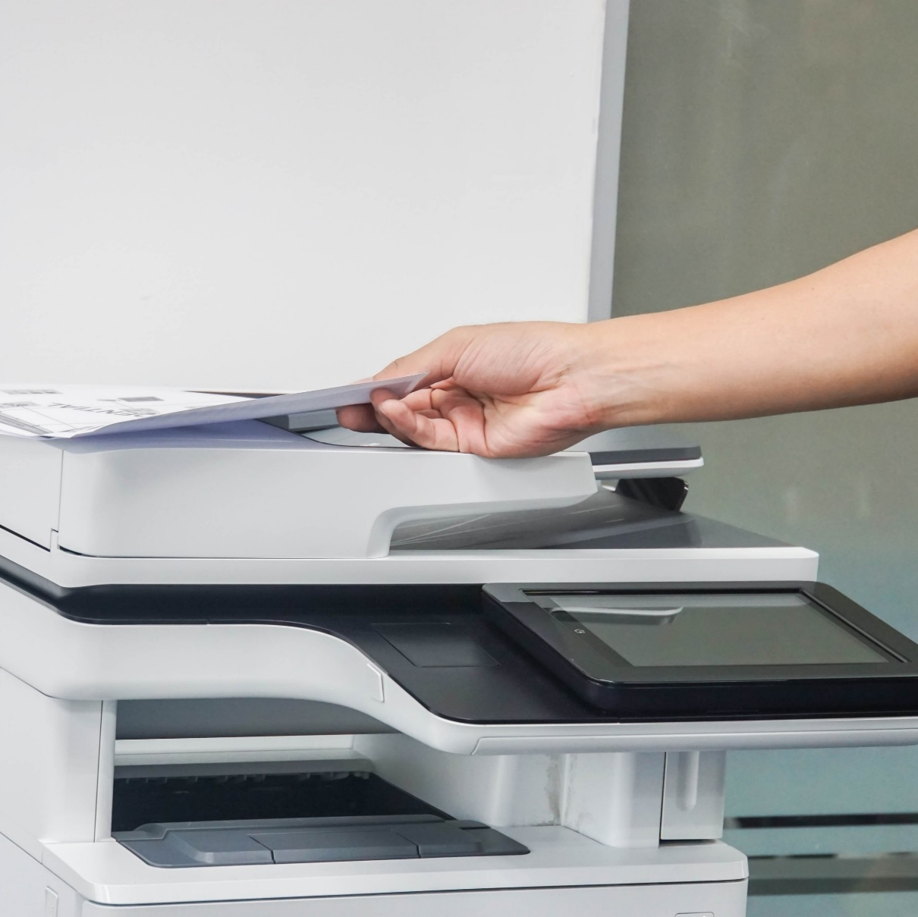
Documents are dangerous!
71%
21%
of all cybersecurity incidents are caused by inadvertent employee actions—including leaving private printed documents unattended
increase over the past year in security vulnerabilities in connected devices including printers, laptops & smartphones
Notes:
In many cases, data loss and security breaches are unintentional.
It happens within corporate walls when confidential personal identifiable information is printed, forgotten in printer trays or left on desktops.
Or when confidential files are left on unsecured laptop hard drives rather than stored in a secure centralized repository.
But the pressure on business leaders is mounting as more devices, including personal devices are being connected to enterprise networks
It’s 2019, enterprises are realizing that Documents are Dangerous!

Slide 5



Documents are vital!
Your enterprise can’t function without bringing in, formulating, and transmitting information. And your information is communicated through documents—both physical and digital.
Notes:
While unsecured documents can be exploited
How could your organization survive without them?
How would your workforce communicate and collaborate within your organization as well as with customer, suppliers and partners?
Documents are vital. They are a necessary tool for getting work done.

Slide 6

Your business is vulnerable
When your documents are not managed and secured,
you are exposing your business to a whole spectrum of risks:
  When documents get into the wrong hands through carelessness or breaches:
  When documents don’t get to the right people at the right times:
  When you cannot accurately monitor and report on document movements:
  Your may have business security as a risk.
  Your business productivity may be suffering.
  You may have regulatory compliance failures.
Notes:
Given these known industry concerns, every organization is now measuring how vulnerable are they. I am sure you in your organization have already started investing in these areas and continue to evaluate where your risk sits.
Across these attributes, what area do you feel is of greatest priority to your organization?
When it comes to your document infrastructure, email, attachments, faxes, printed documents and more, how do you know when a piece of information has been exposed or compromised?
How do you increase the overall productivity of document workflows, while increasing the level of security around those documents?
If you were to audit your document workflows to measure how effectively sensitive information is handled, how long would it take to complete and how much fidelity would you have into those processes?

Slide 7





And there is no single solution.
No one actively manages, secures,
and governs virtually every aspect of information distribution in documents via printing, scanning, routing, and storing throughout the enterprise—across any combination of hybrid systems, technologies, and devices.
Notes:
When you look out to the market, including your existing suppliers, who has approached you with a viable solution to address these vulnerabilities?
When we looked, we could not find a single solution that could secure content at all ends of the enterprise from print, capture, routing, storing and data export across hybrid systems. Across different brands of OEMs, your mobile devices and even desktop.

Slide 8
Until now.
Kofax ControlSuite manages, secures, and governs your documents through unified printing, scanning, and workflow processes—because…
Documents are your business.
Notes:
Until now.
We have introduced a new platform called ControlSuite that manages, secures, and governs your documents through unified printing, scanning, and workflow processes.
Because at the end of the day, documents are your business.

Slide 9
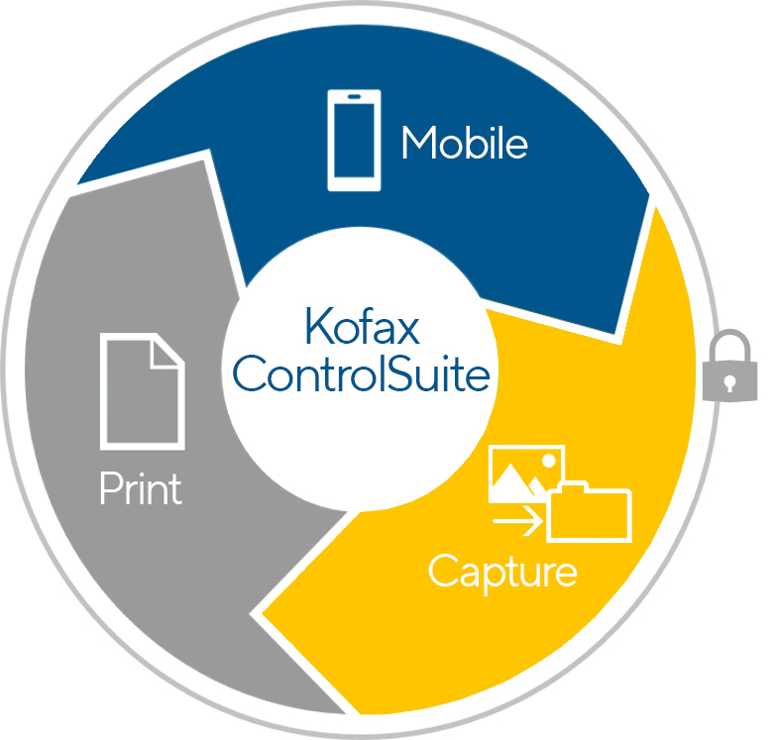
Kofax ControlSuite speeds productivity, minimizes security breaches, and reduces compliance costs with the most intelligent, integrated, and innovative print and capture feature set.
It equips your organization to engage today like the digital workforce of tomorrow.
Notes:
Kofax ControlSuite will increase productivity, minimizes security breaches, and reduces compliance costs with the most intelligent, integrated, and innovative print and capture feature set.
It equips your organization to engage today like the digital workforce of tomorrow.

Slide 10
And the Experts Agree…
ControlSuite is Ripe for the Market
Notes:
And the Experts Agree…
ControlSuite is Ripe for the Market
We validated our approach with them

Slide 11
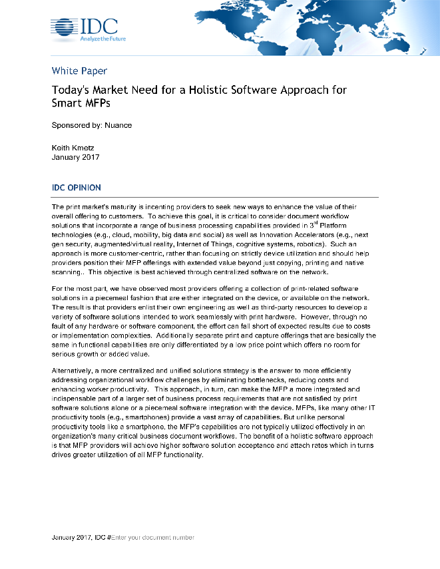
What the industry experts are saying
IDC Whitepaper
The market needs a holistic software approach for smart MFDs
The integrated and holistic solutions tactic should be a consideration for print vendors and their channel partners in order to best serve end user customers
Makes the MFD an essential component in all stages of the company's document
& business processes
Highlights the need to provide an all-inclusive and secure print, capture, & routing package
Offers an opportunity for manufacturers to customize workflows in line with their own
go-to-market strategy
Requires an attractively-priced packaged & integrated software solution versus separately priced
products
2017 IDC Whitepaper: Today's Market Need for a Holistic Software Approach for Smart MFDs
Notes:
IDC did a research study on what people wanted in their next generation print and capture solution and the results came back very definitively they wanted:
A single system that would manage both print and scan at the MFP. They are frustrated having separate solutions to authenticate and not talk to one another when many workflows combine the two.
They wanted integrated workflows that could be kicked off at the MFP or from their mobile or their desktop through an online form. They didn’t want the different workflows just because the input mechanism was different.
Security was critical – they wanted better ways to secure and govern how content was coming and out.
And finally – they wanted to work with a single vendor that was easy to implement and price.

Slide 12
The Value of Integrated Print & Capture
Market Research Study
Organizations react positively to the Kofax ControlSuite proposed solution
84%
84%
72%
Purchase
Consideration
Interest
Value
Want to learn more about the solution
Feel the solution would provide value to the organization
Would consider purchasing
Isurus Market Research and Consulting 2016/2017 Online Market Research Study
Notes:
So we tested these theories and overwhelming it came back that yes organizations would find a combined and integrated platform to manage, secure and govern print of value.

Slide 13
Kofax ControlSuite Critical Capabilities
Notes:
Now let’s dive into the critical capabilities of ControlSuite

Slide 14

An Extensible Platform of Capabilities
Document
security
Document workflow automation
Scanning
& document routing
Business system connectors
Mobile workflows
Document conversion
Document and print stream transformation
Print
avoidance and reduction
Print accountability & auditing
Cloud deployable
Secure document workflow automation platform
No other solution can compare to all these comprehensive capabilities that work together to solve high-value business process challenges
Notes:
ControlSuite is a robust platform to facilitate workflow automation, security and governance across print, capture and output management. Some of those critical capabilities include:
Document security and the ability to only release print once authenticated at the printer or to redact PII data automatically.
Initiate workflow from the MFP, mobile phone or desktop through online forms and all content go through the same workflow engine to determine what business app it should be routed and should any secure data be redacted or should someone approve before stored. The goal is to securely, automate as many manual data entry steps as possible to not only drive productivity but ensure high, quality data input.
We also have a robust set of connectors to business applications to input data to – including expansion into cloud based systems like OneDrive.
As I mentioned mobile is a critical part of ControlSuite. We can not only capture content from mobile devices, but we can release secure print documents as well as authenticate with new Bluetooth, NFC authentication.
Document conversion is also critical. At Kofax we develop and own the market leading OCR engine on the market today leveraged by thousands of software companies. We are continually innovating adding more languages, even greater accuracy for broader array of document types and quick conversion speeds. For instance, we have added even greater support for new document types coming up relative to systems like Google docs, Box and others.
Perhaps one of the most unique values and capabilities of ControlSuite come with the output management capabilities. Here we can add greater security and intelligence into the print stream. We can do things like redact information and pull Data Loss Prevention tags. For example, if a DLP tag says “confidential” we can do things like stop print, or alert someone it is being printed or create workflow where someone can approve print. We can also change content midstream. So if Bank A acquires Bank B, then if someone from Bank B prints we can transform it onto Bank A letterhead automatically.
As with any print management solution ControlSuite contains all the print avoidance and reduction capabilities you would expect – working across a hybrid MFP fleet.
To help with governance, ControlSuite is also creating an audit trail accounting for who brings data in, where data goes and who prints and what is printed. This is critical for adhering to ever changing compliance regulations.
Finally, ControlSuite is cloud deployable. It can be deployed in AWS or Azure.

Slide 15







ControlSuite Delivers Multichannel Support
Different Formats
Different Devices
ControlSuite Workflows™
Scanning &
Document
Routing
Document
Conversion
Print Stream
& Document
Transformation
Print Management
& Reporting
One process with a collection
of advanced capabilities
Multiple Destinations
at the Same Time
Printer
ERP
DMS
Notes:
One of the critical differentiators for ControlSuite is that it is multi-channel or multi-modal.
This means that you can take any form of content – word doc, pdf, cell in an excel spreadsheet, fax or even metadata from any device – mobile, desktop or MFP.
Regardless of type of content or how it comes into the organization, it flows through the ControlSuite workflow engine. Here content is routed to the right location, converted to similar doc types for data manipulation, intelligence is added such as redaction, word stamps, time stamps, etc. And finally here is where everything is tracked and can be reported on.
Then as content flows through the engine it is routed to variety of locations. Same document can be routed differently such a sprint pieces, move some content to an ERP system and others in a DMS system with proper redaction in place.
ControlSuite handles a large breadth of content types that can flow through the engine to be routed as it aligns to any business process with integrated workflows.

Slide 16
Example ControlSuite Workflow
Notes:
Now let’s dive into the critical capabilities of ControlSuite

Slide 17





Business Challenges
?
Docs Need Signatures
Manual Processes
Delays
Lost Revenue
Many business processes have documents that are generated by the business, sent to customers for review and signature, and returned back to the business for processing.
For example:
Legal documents: contracts, leases
Financial documents: loans, mortgages
Insurance: home and life insurance policy
Shipping: bill of lading
The process is often started within a line of business application where the document is printed. This hardcopy document is issued to customer. Customer signs document and returns to business by mail. Business receives document and has to manually process and route document. All steps are manual processes to physically move and extract data.
Often times documents are not returned by customer or there are delays in manual operations.
Delay may result in lost or delayed revenue, long process times, poor customer satisfaction and increased cost to process transaction
Notes:
Now let’s look at some examples. We will start with a typical business process where customer signatures are required.
Many business processes have documents that are generated by the business, sent to customers for review and signature, and then returned back to the business for processing.
All of these processes start within a line of business application where the document is printed.
This hardcopy document is issued to the customer with the request for signature and a return of the document to the office for finalization of the process.
Once the business receives document, it typically has to manually process and route document to the appropriate systems.
Many of the steps are manual, relying on employees to physically move and extract data from within the document and input information into business applications.
Often times documents are not returned by customer in a timely manner or there are delays in manual operations which impacts downstream operations.
Any delays may result in lost or delayed revenue, long process times, poor customer satisfaction and increased cost to process transaction
There are a number of issues with this process:
Potential bottle necks
Manual time consuming tasks
The document processes are inefficient
There is limited to no security or audit trail
Inaccurate document storage can make it hard to retrieve files
And the process, which is a standard business process, lacks any automated steps.
There are definitely a number of things that could be improved with this process.

Slide 18














Leverage ControlSuite to do the following:
1
2
3
Business owner prints document
Without user intervention, automatically apply a unique barcode to the page printed from the line of business application
Create and route PDF of unsigned document to appropriate customer
Customer signs document, but has option to return by mail, email or fax
5
4
Mailed documents are scanned in batch. The unique barcode identifies the document and routes it to the appropriate customer folder marked as ‘complete – signed.’
Faxed and emailed documents are automatically ingested and processed without manual intervention.
Receipt of document at business
Notification option is sent to business owner with link to final document
ControlSuite automation

Slide 19



Results
Employee
End Customer
Business
Employee generating the document: there is no change to the print process or additional steps to take. The barcode is automatically inserted and PDF copy stored to correct location.
End customer has new and more convenient options to return the document (email and fax).
  Returned documents can be scanned in batch, not 1 by 1. Barcode automatically routes to appropriate customer folder
  Email and fax documents are immediately inserted into process without delay or manual intervention
  Proactive notification to line of business owner streamlines process to close transaction sooner
  Unsigned and Signed documents are available as searchable documents to assist in post-transaction account maintenance and customer support effort
  Overall process is streamlined resulting in no change to employee or customer behavior, quicker closure of business transaction and removal of manual steps to process and store documents.
  Single solution leverages print, capture, email, document management and fax system to provide unified, easy to use workflow to automate cumbersome business process
Notes:
All of this will result in:
An improved workflow the requires no change to print process or additional steps to take. The Barcode is automatically inserted on the document and a PDF copy is automatically routed to the correct location.
The documents returned via mail can be scanned in batch, not 1 by 1. The Barcode automatically routes the documents to appropriate customer folder.
The documents received via email or fax documents are immediately inserted into process without delay or manual intervention
And the workflow provides a proactive notification to line of business owner, which streamlines process to close transaction sooner
In addition, Unsigned and Signed documents are available as searchable documents to assist in post-transaction account maintenance and customer support efforts
Overall process is streamlined resulting in no change to employee or customer behavior, quicker closure of business transaction and removal of manual steps to process and store documents.
ControlSuite leverages print, capture, email, document management and fax systems to provide a unified, easy to use workflow that automates cumbersome business processes.
This same type of bar code workflow could be used in many different industries.
In Manufacturing
Bar codes can be used in shipping and receiving where bar codes are used to read, retrieve and archive information, reconcile proof of delivery.
In Healthcare
The use of bar codes can significantly reduce the risk of medical errors in documentation, including the identification of patients, medications, medicals devices, security of patients.
In Insurance
Bar code technology could eliminate the most difficult part of the indexing/scanning process. It will enable insurers to separate and sort folders, so that claim numbers, policy numbers, and document types can be properly identified and easily retrieved (even query databases).
In Education
Admissions offices can use bar codes to validate information. When paper applications and their related documentation-transcripts, counselor information, etc.-are received, a bar code could be created from a student’s ID number and printed.
In Finance
The processing of online forms can be improved upon using bar code technology. Bar codes can be generated when customers print out online forms for signatures. When signed forms are returned to a lending institution, the bar codes facilitate instantaneous association with existing customer files. Users can create bar code sheets that contain indexing information, such as an account number or name, which can be mixed into batches of scanned or imported information. The bar code applies values to appropriate user keys, all without human intervention. This reduces the potential for error and maximizes the number of documents that can be processed at any given time.

Slide 20






Business Challenges
Physical Assets
Quantity &
Location
Inspections
Maintenance
Inventory
Business that manage physical assets often have to inspect various items to deliver regular maintenance, order consumable or replacement parts, perform annual inventory audit, etc.
Example industry and assets:
Office Equipment: printers, MFPs, server assets
Utilities: transformers, generators, transmission equipment
Healthcare: lab and medical equipment
Manufacturing: QA test equipment and assembly line tools and fixtures
Critical assets often require inspection at regular interval. Missed inspection or service may lead to fine.
Maintenance and break/fix of assets requires correct replacement part. Installing proper part or failure to log replacement may introduce asset downtime, wasted time/resource or most importantly dangerous situation.
Business requires accurate inventory of assets. Incorrect asset control leads to poor customer service, expense control issues, poor utilization of employee time and other assets.
The large quantity of assets and wide ranging physical location makes it difficult to monitor and manage business assets.
Notes:
Now let’s look at another example.
Many businesses must manage and inspect physical assets to deliver regular maintenance, order consumables or replacements, perform annual inventory audits, etc. This manually intensive process can present a number of business challenges for organizations such as Utilities Companies, which track and manage transformers, generators, trucks, tools and other equipment. The challenges include:
The large quantity of assets and wide range of physical locations makes it difficult to monitor and manage these assets.
Many of the critical assets have a regular inspection schedule and missing an inspection or service could lead to fines.
When performing maintenance and break/fix of these assets, the correct replacement parts must be available at the asset location. Installing an improper part, or failing to log and track maintenance properly, could lead to additional downtime, wasted time/resources or most importantly dangerous situations.
Businesses require an accurate inventory of their assets. Incorrect asset control can result in poor customer service, expense control issues, and poor utilization of employee time and other assets.

Slide 21




Leverage ControlSuite to do the following:
1
Provide mobile application with the following capabilities:
Read barcode to identify physical asset or to identify replacement parts as they are installed
Perform database lookup for critical info (last service date, future calibration date, asset description, asset owner...)
Capture key information: description of service rendered, date of service, condition of asset, etc.
Capture electronic signature as proof of inspection, service rendered (if required)
Capture the geo-location of asset
Take picture of asset
3
Automated document delivery:
2
Document creation:
PDF
PDF
Where physical certificate of inspection or calibration is required, ControlSuite will automatically print certificate and delivery envelope
Inventory database updated with new information: service date, calibration date, asset owner, etc.
PDF document delivered to electronic archive
All information used to create human readable PDF document
ControlSuite automation
Notes:
With Kofax ControlSuite, this type of workflow could be addressed by scanning an existing barcode with ControlSuite and a standard Mobile device:
Workers can use their Kofax Business Connect application on their mobile device to access a workflow which reads barcodes placed on assets to identify the asset or identify replacement parts as they are installed
With the asset information collected via the bar code, the workflow will automatically do a database lookup to return critical information about the asset, such as the last service date, future calibration date, asset description, asset owner, etc to the worker.
The worker can then update key information about the asset such as a description of service, date of service, condition of asset, etc
Additional information about the exact location of the asset, as well as a picture of asset can be captured or updated.
And in instances where needed, an electronic signature can be captured via the workflow, as proof of inspection, service rendered, etc
Behind this asset tracking workflow, information gathered from the technician such as pictures, signature, geo-location, description as well as data gathered from business systems can be inserted onto a PDF document and delivered to an electronic archive or any downstream business process.
In addition, the asset inventory database will be automatically updated with new information: service date, calibration date, asset owner, etc and in instances where a physical certificate of inspection or calibration is required, this ControlSuite workflow can automatically print the certificate and delivery envelope.

Slide 22
Results
PDF
Mobile Worker
Business
  Streamlined process to capture relevant data
  Immediate access to critical information (service and calibration dates, owner info, etc.)
  Reduced data entry error due to barcode scan, database lookup and automated geo-location
  Increased productivity. Ability to track more assets with better accuracy and customer service.
  Full audit trail and reporting. Minimized financial risk due to missed compliance and to mitigate time required to comply with external audit
  Increased business efficiency due to improved data and increased mobile worked productivity
  Reduction of manual process to file field reports, deliver final documents to repository, print and deliver end-customer certificates, audit reporting
  Improved data accuracy
  Financial reporting improvement due to real time inventory and asset detail
  Reduction in legal liability: failure to inspect or service equipment can lead to injury or death
Notes:
All of this gives mobile workers:
A streamlined process to capture relevant data on assets
Immediate access to critical information about assets
and reduces data entry errors because the barcode scan, database lookup and geo-location of assets is completely automated.
This leads to increased productivity for the worker and the ability to track more assets with better accuracy and customer service.
This also gives the business a number of benefits including:
A full audit trail and reporting on assets which minimizes financial risk due to missed compliance and mitigates the time required to comply with external audits.
Increased business efficiency due to improved data and increased mobile worker productivity
A reduction of manual process to file field reports, deliver final documents to repositories, print and deliver end-customer certificates, audit reporting, etc.
Improved data accuracy
Improvements in financial reporting due to real time inventory and asset detail
and a reduction in legal liability based on the failure to inspect or service equipment which could lead to injury or death.

Slide 23
Kofax ControlSuite is comprised of
Print Management
Capture
Output Management
Security enhancements
New Micro Card Reader with Smartphone authentication
New - Kofax Business Connect mobile app
Enterprise infrastructure enhancements
Improved administration experience
Included scanning capabilities
Included authentication service
New Micro Card Reader with Smartphone authentication
Enhanced - Kofax Business Connect mobile app
Updated data extraction with OpenForms 360 add-on
Healthcare workflows with HL7 and CDA
Many more capture enhancements
Security enhancements
New Micro Card Reader with Smartphone authentication
New Epic connector
Enhanced - Kofax Business Connect mobile app
Enterprise infrastructure enhancements
Advanced deployment options
Included scanning capabilities
Notes:
In summary, all we have is broken across 3 modules that comprise Kofax ControlSuite – (Print Management, Capture and Output Manager).
We are launching an update to our print solution this week which includes:
Security enhancements
New blue tooth or NFC authentication for print
Mobile app now includes ability to release print from the print stream
Improved infrastructure enhancements along with creating a web based administrative tool to make it easier to deploy
Also we have seeded print with basic scan – scan to email, scan to file, etc
Capture has similar set of new capabilities:
New blue tooth or NFC authentication as well as bundled card reader authentication support
Enhanced mobile capture capabilities
Add on for data extraction with OpenForms 360
Greater advancements in healthcare supporting workflows with HL7 and CDA
And Output Manger all similar
New blue tooth or NFC authentication
Security enhancements
New epic connector to help in healthcare
More advanced deployment options for scalability
And finally seeding with basic capture

Slide 24
ControlSuite is More than Just a Product—it is an Experience

Slide 25

The Kofax Customer ControlSuite Experience
Simplified order processing and licensing
Consistent pricing and M&S strategy across all solutions
Single, simplified installer for all modules of ControlSuite
Empower organization with integrated print & capture
Develop innovative workflows that solve your business challenges
Notes:
We have also streamlined the end to end experience for you.
We have simplified ordering and licensing by investing in 3rd party software – making license management easier for you.
Across all modules have consistent, simplified pricing model with same M&S that includes support and major upgrades.
ControlSuite has single installer for all components enabling you to get up and running quickly.
The solution is not only differentiated as we discussed but will drive value in your organization by empowering your solution to do more with integrated print and capture.
Finally, we have ensured we created a solution that you can point to your business challenges

Slide 26
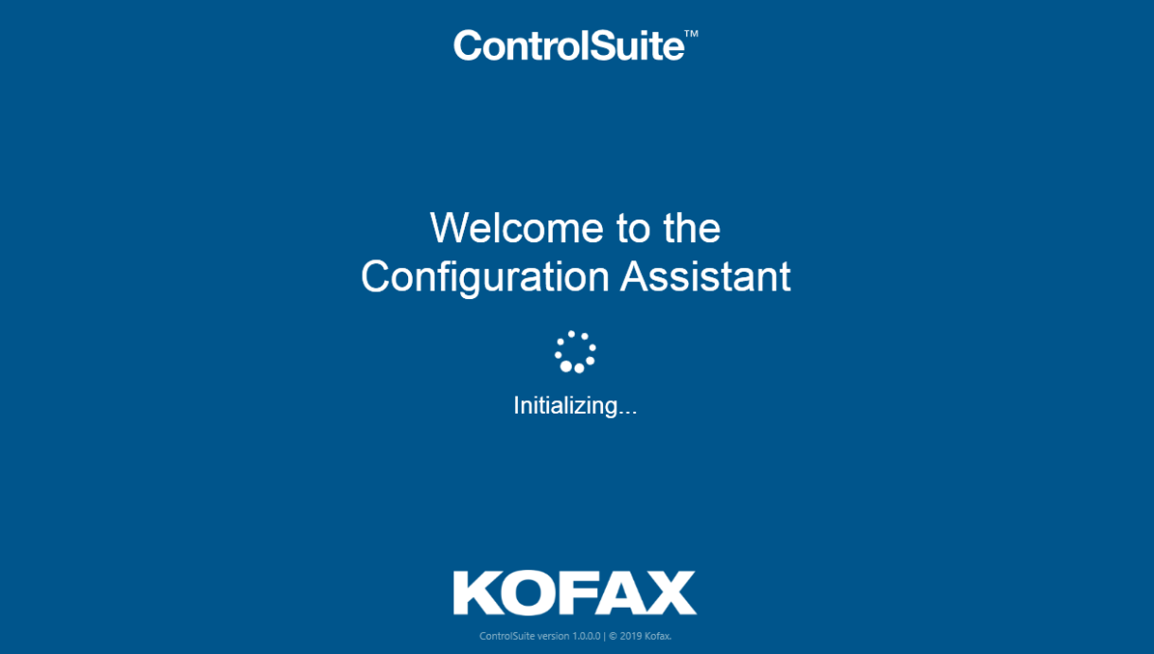
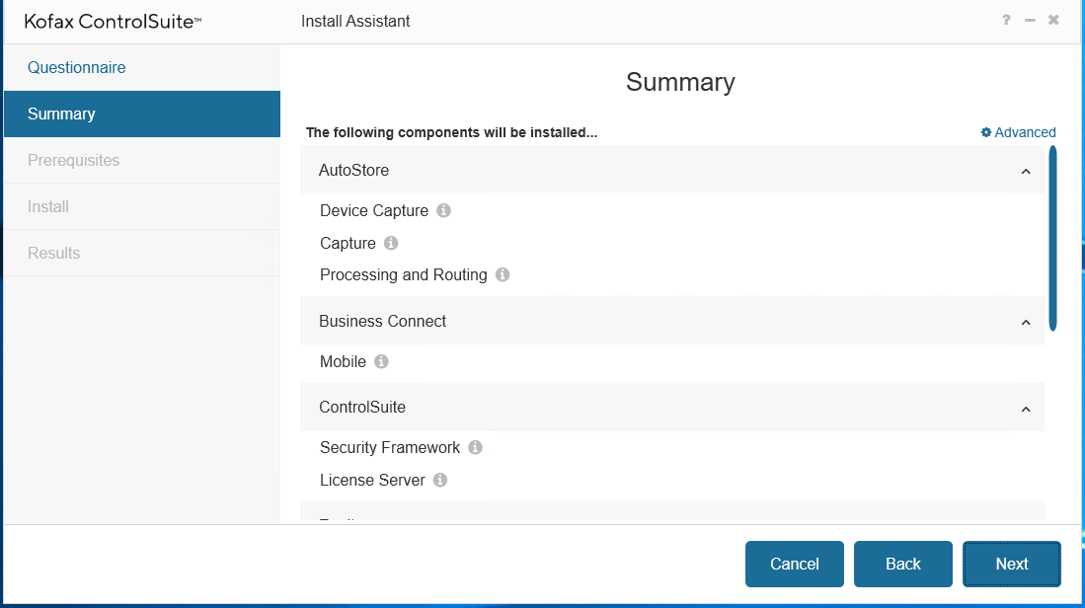
Simplified Install & Configuration Experience
Single installer and configuration for print, capture, output management and mobility
Automated check ensure before start install all pre-requests are met
Modules not purchased greyed out and can be turned on with a licensing change
Notes:
We have also done a lot to make the install experience smarter. We are running pre-checks to ensure all requisites are met and you have the system to support install and config. We will grey out any component not being used so you can see what areas you can expand if you want to.

Slide 27
New Professional Services and Support Programs
Notes:
Now let’s take a closer look at the newest features and functionality that will be included with AutoStore 8…

Slide 28
Support Resources and Offerings
Marlow, UK
Wetzlar, Germany
Waterloo, Canada
Budapest, Hungary
Kofax customer support has world class resources in the following locations that follow the sun around the globe.
Pune, India
Sydney, Australia
Notes:
Performance and reliability are critical aspects of any business application. At Kofax we back up best-in-class solutions with best-in-class support.
Kofax technical support representatives are located in six locations globally that operates in a follow-the-sun capacity. Support technicians not only back each other up but also have direct access to engineering as required to ensure issues and questions are addressed in a responsive and timely manner, 365 days a year.

Slide 29
Kofax Support Services Programs
Partner Support Service Basic support services where partner provides Level 1 & Level 2 |  | Kofax Direct Support Service Premium service where Kofax provides all support |  | Premier Support Service Add-on option for Partner and Kofax Direct Support
Customer contacts partner/reseller for any questions or issues Partner/reseller provides Level 1 & 2 support, with escalation to Kofax Support for Level 3; only partners/resellers with a Kofax contract may contact Kofax Partner/reseller remains point of contact for end customer until issue is resolved Kofax support hours are Monday-Friday, 8am to 5pm local time for escalation |  | Kofax provides all levels of support, without any obligation on the partner or reseller. Partner, Reseller or System Integrators can contact Kofax support on behalf of the customer; the customer may also contact Kofax directly Essential for customers with complex environments, or with multiple hardware brands Kofax support hours are Monday-Friday, 8am to 5pm local time for escalation |  | Essential for customers with mission critical, 24x7 operations, or highly customized deployments Includes a designated Technical Account Manager (TAM) Kofax single point of escalation to coordinate between customer, vendor and Kofax. TAM develops intimate knowledge of customer deployment and relationships with key resources Regularly scheduled open incident reviews Can be added to Partner or Direct support packages Includes Annual Content Control & Systems Assessment (CCSA) performed by Kofax Includes 24x7 availability for Severity 1 issues
Notes:
Kofax offers three options for support, each designed to best meet the needs of customers:
Partner Support: Kofax will provide level 3 coverage to partners who have been trained and enabled to deliver level 1 and 2 support to their customers.
Direct Support: customers can also elect to purchase support from Kofax directly, and receive all levels of coverage from trained Kofax support technicians.
And finally, for customers who’s mission-critical environment demands higher levels of support and hours of coverage, Kofax offers “Premier Support” which entitles 7x24 coverage and access to a designated Technical Account Manager who is familiar with the customer’s environment and acts as a single point of contact to drive incident resolution. This service also provides an annual content control and systems assessment to ensure the customers and is available either direct from Kofax or through Partner Support.

Slide 30
Kofax Professional Services
Packaged Programs for ControlSuite
NEW! ControlSuite QuickStart for SMB For new customers with small environments Quick and basic 2 to 5 Day engagements 1 to 2 servers 3 to 5 devices 2 to 3 workflows Available for AutoStore Foundations/Enterprise Equitrac Foundations/Enterprise Output Manager Foundations/Enterprise ControlSuite Foundations/Enterprise |  | Add-on Capability Services (ACS) Device and workflow add-ons Can stack/combine with other programs Desktop Capture Automation Desktop scanning with AutoStore & QuickCapture Content Control & System Assessment Business process review System performance checkup
Order off price list with SKU
No estimate or SOW required
Datasheets with full scope and deliverables available at Kofax.com
Notes:
New Professional Services packages have been developed to meet a variety of customer needs.
These include new “QuickStart” packages for SMB, which are perfect for single-server deployments and are available in Basic, Standard, and Advanced options.
Quote-based additional services are also available as necessary to supplement QuickStart packages, including Add-on Capability Services, Desktop Capture Automation, and Content Control & System Assessment.

Slide 31
Kofax Professional Services
ControlSuite Upgrade Services & Migration Services
Upgrades: Single Product Detailed project plan Analysis of existing Kofax product installation and configuration Custom design session(s) to explore enablement of new features Kofax server software installation and configuration MFP/printer device initialization Project management Administrative training (1 hour up to 2 users) Available for AutoStore 7 to AutoStore 8 Foundations/Enterprise Equitrac 5 to Equitrac 6 Foundations/Enterprise Output Manager 4 to Output Manager 5 Foundations/Enterprise |  | Migration: Single product to ControlSuite Detailed project plan Analysis of existing Kofax product installation and configuration Custom design session(s) to explore enablement of new features and cross-product integrated workflows Kofax server software installation and configuration MFP/printer device initialization Project management Administrative training (1 hour up to 2 users) Available for AutoStore 7 to ControlSuite Foundations/Enterprise Equitrac 5 to ControlSuite Foundations/Enterprise Output Manager 4 to ControlSuite Foundations/Enterprise
Services scoped/priced per engagement
Requires estimate and SOW
Notes:
Finally, Kofax Professional Services can manage upgrades of your current applications to the most recent versions, and even migrate them to a full ControlSuite solution.

Slide 32
In summary …..

Slide 33



Kofax ControlSuite is a single, easy-to-manage solution that:
Secures your
business information
Makes your enterprise more productive
Ensures your ability
to remain compliant
manages, secures, and governs your documents through unified printing, scanning, and workflow processes.
by ensuring that documents get to all the right people at the right times, every time, through the right workflows and processes.
by meeting compliance regulations with automatically-generated audit trails that track your documents wherever
they go.
Notes:
We walked through a lot today, but want to summarize in the end what is Kofax ControlSuite delivering to you.
We are delivering a single, easy to manage solution that will:
Better protect your organization’s documents and ensure your content is protected through unified printing, scanning and workflow processes
We are making your enterprise more productive by ensuring the right information gets to the right person at the right time. And not only being visible but accurate data.
And finally it ensures your ability to remain compliant by creating an ongoing audit trail tracking every time someone scans or prints content creating a governance trial to ensure compliance and overall reduce the cost of internal and external compliance costs.

Slide 34
Thank you
Notes:
Thank you.

