Slide 1
Kofax AutoStore
Secure, Automated, Distributed Capture
February 2019
Notes:
Hello and thanks for taking the time to speak with me today. On today’s agenda we will be speaking in detail on AutoStore and it’s latest version.

Slide 2



Market Challenges & Pressures
Our market today mandates that organizations employ solutions that help them successfully maneuver through a digital transformation. A focus of this is around content. And how documents comes into an organization via scan, online form capture or mobile capture.
Compliance & Security Risks
Mobile
Workforce
Business Process Efficiency
Notes:
We are in the middle of a digital era. And in this area it requires a new way of working, securing and governing content as organizations progress through their own digital transformation.
This change into the digital world is having huge impacts on how organizations build security and governance around their content. Mobility is another huge factor changing the way we work and how we capture and bring content into our organizations. And finally – in order for organizations to move into this digital age must transform historically paper driven, manual processes into digitally automated workflows to improve efficiencies.

Slide 3



The Future of Digital Work
50%
of structured, repeatable tasks will be automated by 2024
20%
of workers in knowledge-intensive tasks will have
AI-infused software or other digitally-connected technology as a ‘coworker.’
- IDC
Notes:
The future of work is changing. IDC estimates that 50% of structured, repeatable tasks will be automated by 2024. 20% of workers in knowledge-intensive tasks will have AI-infused software.

Slide 4
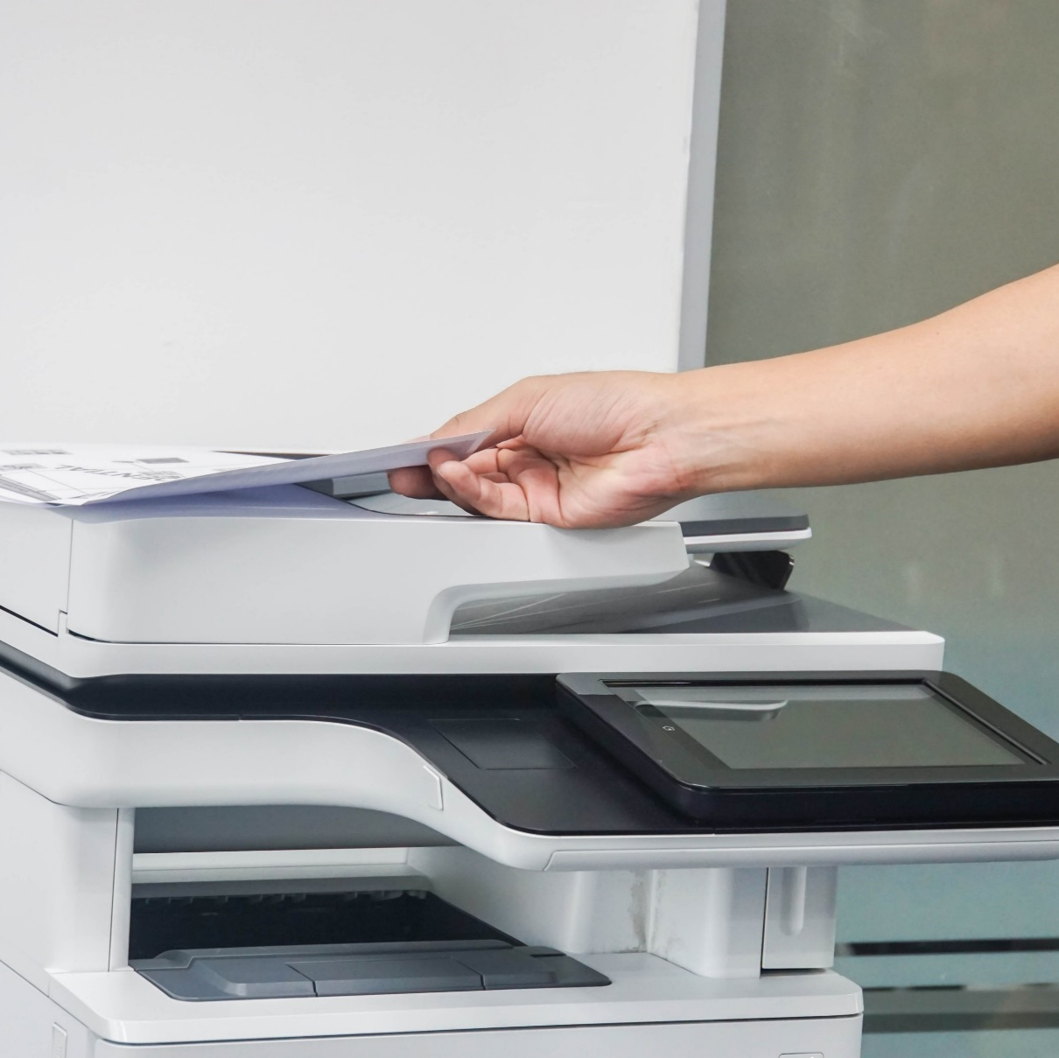

And While We Get to that Future State – Our Work is at Risk
71%
21%
of all cybersecurity incidents are caused by inadvertent employee actions—including leaving paper documents unattended
increase over the past year in security vulnerabilities in connected devices including printers, laptops & smartphones
Notes:
While we move to that future state of work, we need to be aware of security concerns as well.
In many cases, data loss and security breaches are unintentional.
It happens within corporate walls when confidential personal identifiable information is printed, forgotten in printer trays or left on desktops.
Or when confidential files are left on unsecured laptop hard drives rather than stored in a secure centralized repository.
But the pressure on business leaders is mounting as more devices, including personal devices are being connected to enterprise networks
It’s 2019, enterprises are realizing that Documents are Dangerous!

Slide 5




What if you could help your customers…
Reduce or eliminate security risks when information enters the organization?
Improve office worker productivity with intuitive automated document workflows?
Simplify the complex compliance rules that govern important business processes?
Reduce the cost of document security and compliance with distributed multichannel capture?
Notes:
Minimize their security risks and avoid compliance issues and the resulting regulatory fines?
-- Help ensure that they secure all vulnerabilities and network gaps to minimize the risk of cyberthreats including their printers and print management software
-- Deliver secure, enterprise level solutions including print management software to minimize the security risks that printers pose and improve document security
-- Provide print management software that provides multiple ways of authenticating using a mobile device including NFC/ Bluetooth authentication to enable employees to print securely from anywhere and from any device thus minimizing the risk of a security breach.
Drive digital transformation and business outcomes?
-- Provide multi-faceted, feature rich solutions that scale easily in any environment, from small businesses to large enterprises with multiple offices and thousands of devices.
Improve business process efficiencies and reduce cost of operation?
-- Deliver secure, enterprise level solutions including print management software to minimize the security risks that printers pose and improve document security
Expertly manage the mobile print challenges and their security risks?
Deliver print management software that provides multiple ways of authenticating using a mobile device including NFC/ Bluetooth authentication to enable employees to print securely from anywhere and from any device thus minimizing the risk of a security breach.

Slide 6
With secure, automated, distributed capture
Automated capture requires organizations pre-define just once
Based on document content, check against business rules and process and route based within the defined policy – regardless of format and how content comes in.
What information needs to be processed?
What format it needs to be processed in?
What destination(s) it needs to be routed to?
Who needs to be notified?
Notes:
The answer is the next generation of secure, automated and distributed capture. Here we can take information in from a variety of formats and inputs (scanners, desktops, mobile phones, faxes) and normalize the data to process through workflows and drive output into various destinations to ensure the right content gets to the right application or person to drive positive business applications.
As documents come into the organization these workflows will check against business rules to ensure they are routed to the right location.
For the next set of slides, we are going to walk through Kofax AutoStore which helps do exactly what I just said.

Slide 7
Introducing Kofax AutoStore

Slide 8
Kofax AutoStore helps…
Mitigate and minimize security risks by enforcing user and document centric capture policies
Reduce the risk of failed compliance audits
Increase workforce productivity by eliminating manual document processing tasks
Increase information flow and quality through more robust document processing
Provide a unified user experience for managing information capture, processing and routing
Email
Fax
Mobile
Desktop
MFP
Scanner
Notes:
AutoStore delivers the most powerful and flexible document capture solution on the market. Its’ superior security and workflow automation features help organizations close the information security gap, increase office worker productivity and improve enterprise compliance.
AutoStore’s multi-faceted, feature rich capabilities scale easily in any environment, from small businesses to large enterprises with multiple offices and a myriad of different capture interfaces including email applications, desktop files, MFPs, desktop scanners, mobile devices and more. As a critical of ControlSuite, customers gain the beneficial option to upgrade to ControlSuite to realize greater document security and workflow automation benefits by leveraging the entire platform.
Mitigate and minimize document security risks by transparently embedding information detection, protection and approval processes to capture workflows from any capture channel
Enables detection of sensitive information using OCR and advanced capture
Can automatically watermark or stamp sensitive documents and redact sensitive information
Automatically route documents for approval, or to secure centrally managed systems, like an ECM system with password protection and encryption
All without requiring the user to make any ambiguous decisions
Reducing the complexity of compliance
Standardized compliance policies by embedded predefined workflow steps that ensure consistent information governance by document type or user
Track documents for future auditing or create alerts when potential patterns of abuse arise
Reduce the cost of security and compliance
Embed security controls at the start of any document process
Track document movements, activities and workflows in consistent manner
Reduce the burden of training on office workers and more quickly adapt to change regulations and compliance policies

Slide 9
AutoStore captures, processes & routes content automatically
Extend business processes to any device, delivering information to any business application.
Capture
Process
Route
Convert paper to digital
Enhance documents
Lookup information
Extract Information
Match documents to
DB and LOB Records
Format to business application requirements
Electronic Health
Record systems (EHR)
Electronic files
Multifunction devices (MFDs), network scanners
Enterprise Resource Planning
systems (ERP)
Customer Relationship Management systems (CRM)
Smart devices
TWAIN/ISIS
document scanners
Open connectivity
Notes:
You can break AutoStore capture workflows down into 3 main parts:
First you capture the document, which can be electronically at the desktop, from the MFP scanning, or even smart devices.
Then we process the image and the content using our leading edge OCR technology to convert the document into digital format, enhance quality of the document, extract content as needed (or redact it), match to existing records and transform to the business apps.
Finally based on transformed documents routed to proper business applications based on workflow rules. With latest integration to print can also queue up in a print que.

Slide 10




Kofax Autostore Main Capabilities
Capture heterogeneous data from any input device.
Smart workflows – easy to configure and roll out.
Desktop PC / Office
Secure a tight integration into your business process.
Personalized scan menus.
Multifunction Devices (MFDs), Network Scanners
Captures paper and electronic documents.
Stop the unauthorized flow of sensitive information.
ISIS & TWAIN Document Scanners
DOC
XLS
PPT
Convert hardcopy originals into the latest word, excel and PPT formats.
Always get the best scan settings for the job.
Smart Devices
Notes:
Core capabilities within capture are:
Capture content from any type of device
Align workflow with critical business processes – to remove manual effort
Take both paper and electronic doc and align to the same automated workflow
A great capability is how often do you get a hard copy of something – contract, power point presentation, etc and want to make edits. Here you can scan it and will covert to original format so you can now start editing. AutoStore offers one of the most accurate document conversion capabilities to support this use case.
We already talked about workflows – the smart elements is we can enable redaction of PII type of data, add wordmarks if specific metadata, and more
At the device for scanning we can have personalized menus to highlight workflows most critical to the user who has logged in
As mentioned in workflow we can not only redact but we can stop information that has PII data from even going into a business applications if the proper security settings are not enforced
And finally AutoStore takes over the UI at the MFP and can ensure all settings are optimized delivering users the best experience without having to think about what they want

Slide 11
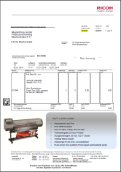

Example Workflow: Accounts Payable Invoicing
Capture invoices and kick-off automatic payment process
Automatic scanned document image clean-up
Convert documents to Searchable PDF
Correct data is extracted from the database
Original document backed up to searchable database
Payment information
is posted to accounts payable business system
1
3
The PO number from the invoice is entered and the invoice is scanned at MFD
Searchable PDF invoices are archived in back-up database
Back-up original document database
2
1
Invoice converted to searchable PDF, the PO number is matched with the database/ accounting system and payment details pulled from the database
4
2
5
Date of receipt of invoice, recipient information and payment details are posted to vendor accounts payable record in business system
3
Accounts Payable Business System
4
AutoStore
Notes:
Here is just one example of the many workflows we could automate for you.
We can scan a purchase order at the MFD and again the user will see any preferences personalized for them. At this point invoice is can be converted to a searchable PDF and we find that a PO number matches the database we are looking against – perhaps it is their vendor accounts payable system. Here we can extract additional data and take any action required (like redact info). Now with combined at can post payment information to the business system. We can also store the searchable PDF and all content in a back up database.
This is only one example of many that can be automated through AutoStore. The key is any document format and any workflow can be supported and integrate content coming in with other business systems of record.

Slide 12









Key Differentiating Factors
Business process capture workflows – AutoStore is ideally suited for document capture into business process workflows, especially those workflows that employ sophisticated business rules to optimize efficiency and security."
Document transformation – Capturing both paper and electronic documents into a uniform process from virtually any device whether it is in the office or on the go improves productivity and workflow efficiency. PDF and PDF/A support enables documents to be easily searched for information. Capture from email turn them into actionable digital information.
Fast and easy image enhancement – The software automatically remedies capture issues in cameras and smartphones, such as low-quality camera photos, distorted document perspective and warped text, to deliver high-quality images through Kofax Business Connect.
.
Enhanced security and compliance – Through dynamic text redaction, AutoStore enables organizations to protect sensitive information without actually searching for any data on the image file. The software matches data on the image file against a specified dictionary and automatically redacts matching data, enabling the organization to more effectively protect personal information and meet compliance demands.
Enterprise business support – A standard interface for scanning and printing, 40+ Document Management System (DMS) routing components, a Forms Overlay component and greater flexibility when routing to RightFax all provide the ability to reduce complex operations into greatly simplified workflows at the touch of a button. This is all while supporting hybrid of MFPs & scanners.
AutoStore – Business-critical document capture you can count on, time after time
Notes:
Walk through differentiators that matter to the customer.

Slide 13
New Capabilities in Kofax AutoStore 8
Notes:
Now let’s take a closer look at the newest features and functionality that will be included with AutoStore 8…

Slide 14



AutoStore 8.0 Enhancements Highlights
Enhanced Mobility
Enhanced data capture on mobile devices combined with Bluetooth and NFC authentication from mobile device for scanning at the MFP.
ControlSuite Integration
Integration with Equitrac 6 and Output Manager 5 in ControlSuite adds the ability to capture print streams and access meta-data into workflows to convert an incoming print stream while converting document formats.
Vertical Market Routing
Enhanced vertical market support for healthcare with HL7 workflow support and Kofax PowerShare integration.
Improved Usability & Workflow
Unified capture allows users to install across device sets while new PDF capabilities help customers integrate output with downstream business processes and database lookup makes it easy to find what is needed.
Notes:
AutoStore 8 offers valuable new capabilities in four areas:
1) Enhanced mobility we have improved our mobile capture overall and added the ability to authenticate with a smartphone at the MFP via Bluetooth or NFC authentication. Additionally, with Business Connect users can submit and release print jobs and even edit image quality on the device.
2) Integration of ControlSuite means that AutoStore 8 has the ability to capture workstreams directly from Equitrac 6 and Output Manager 5, process metadata from those print streams, add watermarks and user stamps, and transform document PDF formats.
3) AutoStore's library of output destinations is expanded in AutoStore 8 with the introduction of new Healthcare and legal process and route components. For healthcare, AutoStore 8 is able to create properly formatted HL7 documents and create CDA templates. Additionally AutoStore 8 has added a PowerShare route component for healthcare, and new ProLaw route component for legal offices.
4) Finally, AutoStore 8 eliminates the need to recreate workflows when deploying to mixed-fleets. Now, workflows can be created once and deployed across a variety of MFP brands that use the Unified Client. Additionally, new PDF merge and database lookup capabilities help reduce and simplify the task of document and information capture.

Slide 15
New Mobile Capabilities: Business Connect
Email
Cross platform integration
    Capture
    Print Management
    Authentication
On-device image processing services
Authentication through Bluetooth or NFC technologies
Fax
Mobile
Desktop
MFP
Scanner
Notes:
AutoStore with Business Connect can be just as mobile as workers are.
With AutoStore 8 we are introducing several new mobile enhancements through the Business Connect client, including:
On-device image cleanup, which enables users to crop, despeckle and deskew images on their mobile device and also preview the edited version to ensure it’s right before submitting to a workflow.
Users can manage print queues and submit print jobs to Equitrac or Output Manager.
Smart devices can be used for authentication at the MFP via bluetooth or NFE technologies.
Additionally, Business Connect UI screens can now be customized to display company logos and colors to promote a seamless integrated look and feel across business applications.

Slide 16
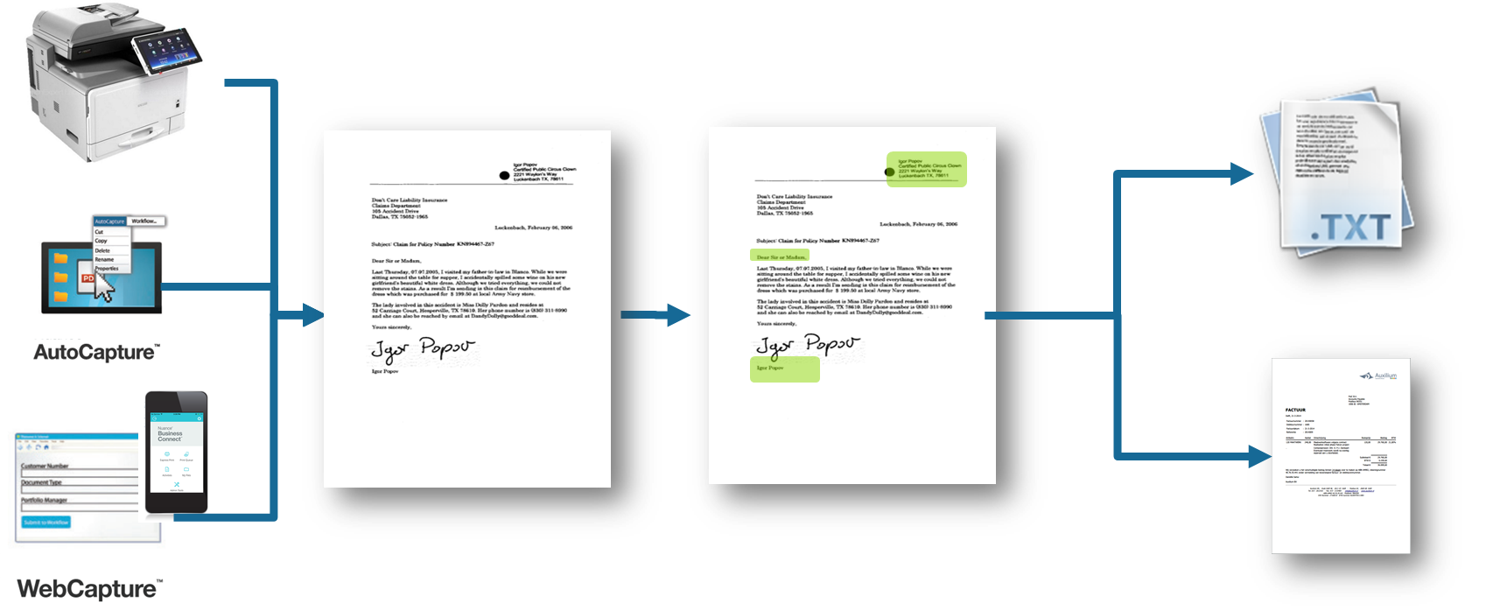
OpenForms 360 version 8 support*
This is an optional add-on feature. Please make that clear. You have notes on here that make this slide incomplete.
Document separation, classification, data extraction and validation based on intelligent document recognition technology
Adaptive learning capabilities for continual process optimization
Simplified configuration and deployment from within AutoStore
Simplified pricing model
Validation station now included in Extraction licenses.
Ideal for applications like Invoice Processing, Claims Processing, Employee and & New Customer Onboarding
OpenForms 360
Unstructured Document Processing
*This is an optional add-on for Kofax AutoStore
Notes:
OpenForms 360 v8 uses advanced document recognition technology to automatically process images and extract information based on content. This capability dramatically improves back office efficiencies and accuracy of work, whether processing structured, semi-structured, or even unstructured documents.
Applications such as Invoice Processing, Claims Processing and Onboarding benefit significantly from OpenForms’ ability to
V8 features a much simplified pricing model, with all key functionality now bundled into product packages rather than being ala-carte as in the past. For example, Verification Stations, which are so important in processing of unstructured documents, are now included with a base extraction license.
Additionally, OpenForms 360 v8 is based on an updated technology platform that offers improved performance and adaptive learning capabilities that enable ongoing improvements to overall efficiency.

Slide 17



Routing Integration Additions and Updates
New
Updates
PowerShare
  Secure, real-time clinical image, report & data exchange & management system
  Highly scalable platform that can be implemented in days
Prolaw
  Business management solution for law firms and departments
  Automates the practice and management of business of law services
Microsoft OneDrive
  Store and access files and photos from anywhere, on any device.
  Share and work together with anyone
D3 7.2
IBM Datacap 9.0 SP1
IBM ContentManager 8.5
IBM FileNet P8 5.2.1
Notes:
More horizontal and vertical routing integration options means greater flexibility and deeper value all from one platform.
Healthcare:
PowerShare route component, enabling connectivity to Nuance’s popular PowerShare Network that connects healthcare facilities, providers, and patients for quick, convenient, cost-effective and secure sharing of medical images and diagnostic reports – anytime, anywhere.
HL7 and CDA Builder process components for transmission of documents and information via standardized formats and templates used extensively in the healthcare industry.
Legal
Connectivity to ProLaw, a popular application used by many law firms for managing documents related to cases.
SMB and Enterprise
Ability to route documents directly to OneDrive and OneDrive for Business.
Updates:
Several route components have been updated to support newer versions of the backend applications:
D3 version 7.2, Database management system update
IBM Datacap, advanced capture application
IBM Content Manager, Enterprise Content Management solution
IBM FileNet P8, Enterprise Content Management and Business Process Management application.

Slide 18
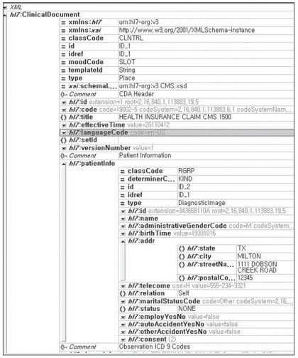
HL7* Messenger & CDA Builder
add to slide 56 as a feature? Which edition?
Create and manage patient healthcare documents
Includes “Messenger” & “Builder” components
Capabilities:
  Use patient ID to find the patient record
  Create a CDA* compliant document
  Attach scanned documents
  Compile it into a standard HL7 compliant record entry for import into a health records or related system
*CDA = Clinical Document Architecture
  XML data schema (see the image)
*HL7 = non-xml defined document data
Notes:
The new HL7 Messenger and CDA Builder components mentioned on the last slide offer enhanced compatibility with healthcare systems that rely on those formats and technologies.
AutoStore 8’s HL7 route component allows images and data to be formatted into the Health System 7 (HL7) standard, ensuring information can be properly shared and processed by the many different applications used in the healthcare industry and accessible to healthcare providers across organizations.
Clinical Document Architecture (CDA) is a standard developed by Health Level 7 (HL7) International that defines a structure for medical records to ensure a better exchange of information among providers and patients. AutoStore v8 includes a CDA Builder that enables creation of a CDA document template which can then be formatted into an HL7 compliant record.
With AutoStore 8, data fields from a CDA document can be used as RRTs for automated processing of documents, thereby streamlining the flow of information.

Slide 19

PDF Merge
Is this new? add to slide 56 as a feature?
Merges existing PDFs into a single PDF document
Enables multistep workflows that require programmatic combination of multiple documents to complete a task
PDF
PDF
PDF
Example: creating a consolidated mortgage package for aftermarket resale
PDF
Notes:
Kofax Advantage:
Automate complex PDF workflows with minimal or no user intervention to produce consistently formatted and secure documents within any workflow.
The updated Binder component in AutoStore 8 adds the ability to merge PDF documents based on conditions that can be pre-defined by an administrator. This simplifies business workflows by ensuring that relevant documents are compiled into complete records rather than being dispersed into multiple different files.
Mortgage documents are a good example of the benefits of PDF Merge. Imagine a collection of related documents, all necessary for processing a mortgage application, easily combined into smart packages based on the needs of the underwriting department. This would greatly simply the process of record review and document management, which improves productivity and shortens cycle-times.

Slide 20
AutoCapture Database Lookup
Is this new?
Brings the MFP client capability to the Desktop
Simplifies the entry and capture of metadata associated with a document
Increases productivity & ease of use at the desktop
Improves the performance of workflow applications that originate at the desktop
Notes:
The ability to automatically populate fields with information from backend databases is a coveted attribute of capture workflows because it not only simplifies and speeds-up the process of data entry but also helps ensure information is consistent and correct.
This advanced capability, which has long been available at the MFP, now comes standard with AutoCapture, thereby further extending AutoStore's inherent capabilities to desktop users across the enterprise.
A typical use-case example for database lookup is invoice processing. With database lookup, users need only enter one field, such as a customer number, to have other fields automatically populated, such as address, contact name, P.O. numbers etc. This capability can dramatically shorten the time necessary to enter a new document into a business workflow, and reduce the number of steps necessary for the workflow to process.

Slide 21
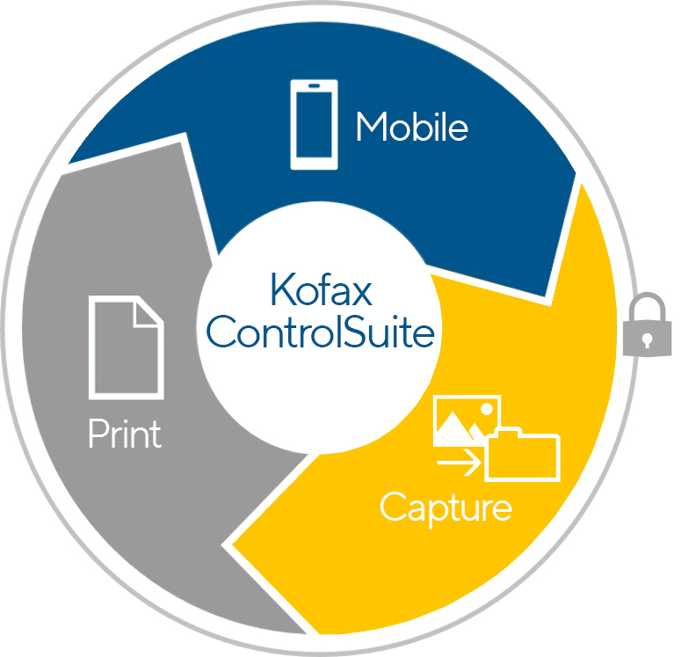
Print and Output Management Integration
AutoStore 8 includes basic authentication provided by either Equitrac 6 or Output Manager 5
Ability to integrate natively with Kofax Equitrac 6 and Kofax Output Manager 5
User-based pricing and licensing that entitles all users to access Kofax AutoStore workflows via AutoCapture, Webcapture, Mobile Capture and MFP capture
Notes:
AutoStore 8 is a ControlSuite application, and as such it integrates natively with Equitrac 6 and Output Manager 5.
Through this integration AutoStore 8 can:
leverage Equitrac's authentication capabilities for streamlining and simplifying the process of user logon.
Initiate capture workflows from print streams
Submit documents into print queues
Transform documents by applying user stamps, watermarks, and conversion of print streams into PDF.
Additionally, the new license and pricing model means all users are enabled for AutoCapture, Webcapture, and Business Connect, putting the power of AutoStore in the hands of more workers in more locations. No more need to purchase those licenses separately – it's all included.

Slide 22











Integrated ControlSuite Workflows
Asset Management Use Case Example
1
Provide mobile application with the following capabilities:
Read barcode to identify physical asset or to identify replacement parts as they are installed
Perform database lookup for critical info (last service date, future calibration date, asset description, asset owner...)
Capture key information: description of service rendered, date of service, condition of asset, etc.
Capture electronic signature as proof of inspection, service rendered (if required)
Capture the geo-location of asset
Take picture of asset
3
Automated document delivery:
2
Document creation:
PDF
PDF
Where physical certificate of inspection or calibration is required, ControlSuite will automatically print certificate and delivery envelope
Inventory database updated with new information: service date, calibration date, asset owner, etc.
PDF document delivered to electronic archive
All information used to create human readable PDF document
ControlSuite automation
Notes:
Document workflow efficiency has been liberated from the office, and can now be accessed anywhere by anyone.
Here's an example of a sophisticated Asset Management use-case made simple by Business Connect:
After scanning the asset barcode with a smart device and triggering a database lookup, additional information can be entered by the user and a geo-location tag can be applied. The worker can then snap an image of the asset and capture an electronic signature from the asset custodian, thus completing the task of asset verification. From there, with a simple button press the record is automatically converted into a PDF document and delivered to an electronic archive while relevant metadata is simultaneously transmitted to an ERP database, after which a physical certificate of completion is automatically generated and sent to the responsible agent.
That's productivity. That's efficiency. That's simplicity.
Kofax Business Connect helps remote workers accomplish more with higher quality than ever before.

Slide 23
System Security Enhancements
This seems really important – move to the beginning?
Adds security control for documents in process
Prevents unauthorized accessed to documents at any point within the system workflow
Allows discrete security rules in the document staging area
Notes:
Security is top of mind anytime important business documents are being accessed or processed. AutoStore 8 enhances the safekeeping of sensitive information by locking down access to documents that are in-process.
AutoStore 8's Server Document Protection enables administrators to set permission levels for folders that are used by the system, in order to guard against unauthorized access while documents are being processed by the workflow.
Distinct permissions can be set for each task, so they can be specific to the demands of the workflow.

Slide 24

Kofax AutoStore in the Cloud
Deployment convenience
New with AutoStore 8.0
Cloud deployable in private Cloud instances
Customer can host their own instance of AutoStore for their organization
AutoStore supports common Cloud OS implementations
Cloud instances must follow deployment specifications for operating system support
AutoStore supports major Cloud hosting vendors
    Microsoft Azure
    AWS Amazon Cloud
    IBM Cloud
    Google Cloud Platform…
Cloud Deployment Overview
+ = dependent upon specific embedded clients
Notes:
Private instances of AutoStore 8 can now be deplyed in the cloud. Autostore 8 supports major cloud hosting vendors:
Microsoft Azure
Amazon AWS
IBM Cloud
Google Cloud Platform
Specifications for deployment are described in the AutoStore Datasheet and the Installation guide.

Slide 25
Kofax AutoStore 8 Version Overview
Kofax AutoStore Foundations |  | Kofax AutoStore Enterprise
 |  | Includes all Foundations features plus:
Capture Image Enhancements, OCR, File Conversions |  | High Availability
1D Barcode Detection |  | Business Process Automation (40+ Connectors)
Business Process Automation (25+ Connectors) |  | Follow-You Print (via mobile, ethernet card reader, embedded client) | New
Mobile capture |  | Mobile print submission and release | New
Authentication (card swipe/user name password/Bluetooth & NFC/Business Connect) | New | Enhanced security (Watermarking/User information stamping) | New
Notes:
AutoStore 8 is available in two editions: Foundations and Enterprise
AutoStore 8 Foundations provides the essentials needed for secure document capture, including:
Image enhancements, OCR, file format conversion capabilities, and 1D barcode detection
25 route destinations such as email, folder, cloud storage, database, LAN Fax, and many other popular applications.
Mobile capture through Business Connect
Card authentication through Equitrac via card swipe or mobile device using Business Connect
AutoStore 8 Enterprise includes all the capabilities of Foundations, and adds
High Availability
Expansion of route connectors to over 40 backend systems
Follow-you print via mobile device using Business Connect
Mobile print submission and release
Enhanced security through watermarking and user-stamping.

Slide 26
Professional Services and Support Programs

Slide 27
Support Resources and Offerings
Marlow, UK
Wetzlar, Germany
Waterloo, Canada
Budapest, Hungary
Kofax customer support has world class resources in the following locations that follow the sun around the globe.
Pune, India
Sydney, Australia
Notes:
Performance and reliability are critical aspects of any business application. At Kofax we back up best-in-class solutions with best-in-class support.
Kofax technical support representatives are located in six locations globally that operates in a follow-the-sun capacity. Support technicians not only back each other up but also have direct access to engineering as required to ensure issues and questions are addressed in a responsive and timely manner, 365 days a year.

Slide 28
Kofax Support Services Programs
Partner Support Service Basic support services where partner provides Level 1 & Level 2 |  | Kofax Direct Support Service Premium service where Kofax provides all support |  | Premier Support Service Add-on option for Partner and Kofax Direct Support
Customer contacts partner/reseller for any questions or issues Partner/reseller provides Level 1 & 2 support, with escalation to Kofax Support for Level 3; only partners/resellers with a Kofax contract may contact Kofax Partner/reseller remains point of contact for end customer until issue is resolved Kofax support hours are Monday-Friday, 8am to 5pm local time for escalation |  | Kofax provides all levels of support, without any obligation on the partner or reseller. Partner, Reseller or System Integrators can contact Kofax support on behalf of the customer; the customer may also contact Kofax directly Essential for customers with complex environments, or with multiple hardware brands Kofax support hours are Monday-Friday, 8am to 5pm local time for escalation |  | Essential for customers with mission critical, 24x7 operations, or highly customized deployments Includes a designated Technical Account Manager (TAM) Kofax single point of escalation to coordinate between customer, vendor and Kofax. TAM develops intimate knowledge of customer deployment and relationships with key resources Regularly scheduled open incident reviews Can be added to Partner or Direct support packages Includes Annual Content Control & Systems Assessment (CCSA) performed by Kofax Includes 24x7 availability for Severity 1 issues
Notes:
Kofax offers three options for support, each designed to best meet the needs of customers:
Partner Support: Kofax will provide level 3 coverage to partners who have been trained and enabled to deliver level 1 and 2 support to their customers.
Direct Support: customers can also elect to purchase support from Kofax directly, and receive all levels of coverage from trained Kofax support technicians.
And finally, for customers who’s mission-critical environment demands higher levels of support and hours of coverage, Kofax offers “Premier Support” which entitles 7x24 coverage and access to a designated Technical Account Manager who is familiar with the customer’s environment and acts as a single point of contact to drive incident resolution. This service also provides an annual content control and systems assessment to ensure the customers and is available either direct from Kofax or through Partner Support.

Slide 29
Kofax Professional Services
Packaged Programs for ControlSuite
NEW! ControlSuite QuickStart for SMB For new customers with small environments Quick and basic 2 to 5 Day engagements 1 to 2 servers 3 to 5 devices 2 to 3 workflows Available for AutoStore Foundations/Enterprise Equitrac Foundations/Enterprise Output Manager Foundations/Enterprise ControlSuite Foundations/Enterprise |  | Add-on Capability Services (ACS) Device and workflow add-ons Can stack/combine with other programs Desktop Capture Automation Desktop scanning with AutoStore & QuickCapture Content Control & System Assessment Business process review System performance checkup
Order off price list with SKU
No estimate or SOW required
Datasheets with full scope and deliverables available at Kofax.com
Notes:
New Professional Services packages have been developed to meet a variety of customer needs.
These include new “QuickStart” packages for SMB, which are perfect for single-server deployments and are available in Basic, Standard, and Advanced options.
Quote-based additional services are also available as necessary to supplement QuickStart packages, including Add-on Capability Services, Desktop Capture Automation, and Content Control & System Assessment.

Slide 30
Kofax Professional Services
ControlSuite Upgrade Services & Migration Services
Upgrades: Single Product Detailed project plan Analysis of existing Kofax product installation and configuration Custom design session(s) to explore enablement of new features Kofax server software installation and configuration MFP/printer device initialization Project management Administrative training (1 hour up to 2 users) Available for AutoStore 7 to AutoStore 8 Foundations/Enterprise Equitrac 5 to Equitrac 6 Foundations/Enterprise Output Manager 4 to Output Manager 5 Foundations/Enterprise |  | Migration: Single product to ControlSuite Detailed project plan Analysis of existing Kofax product installation and configuration Custom design session(s) to explore enablement of new features and cross-product integrated workflows Kofax server software installation and configuration MFP/printer device initialization Project management Administrative training (1 hour up to 2 users) Available for AutoStore 7 to ControlSuite Foundations/Enterprise Equitrac 5 to ControlSuite Foundations/Enterprise Output Manager 4 to ControlSuite Foundations/Enterprise
Services scoped/priced per engagement
Requires estimate and SOW
Notes:
Finally, Kofax Professional Services can manage upgrades of your current applications to the most recent versions, and even migrate them to a full ControlSuite solution.

Slide 31
Thank you
Notes:
Thank you.

